Slide 1



Session 4
  Drugs in the Human Body

Slide 2
Learning Objectives
Describe major systems in human body
Identify methods of administration and general effects of drugs
Identify medical conditions that may mimic drug impairment

Slide 3
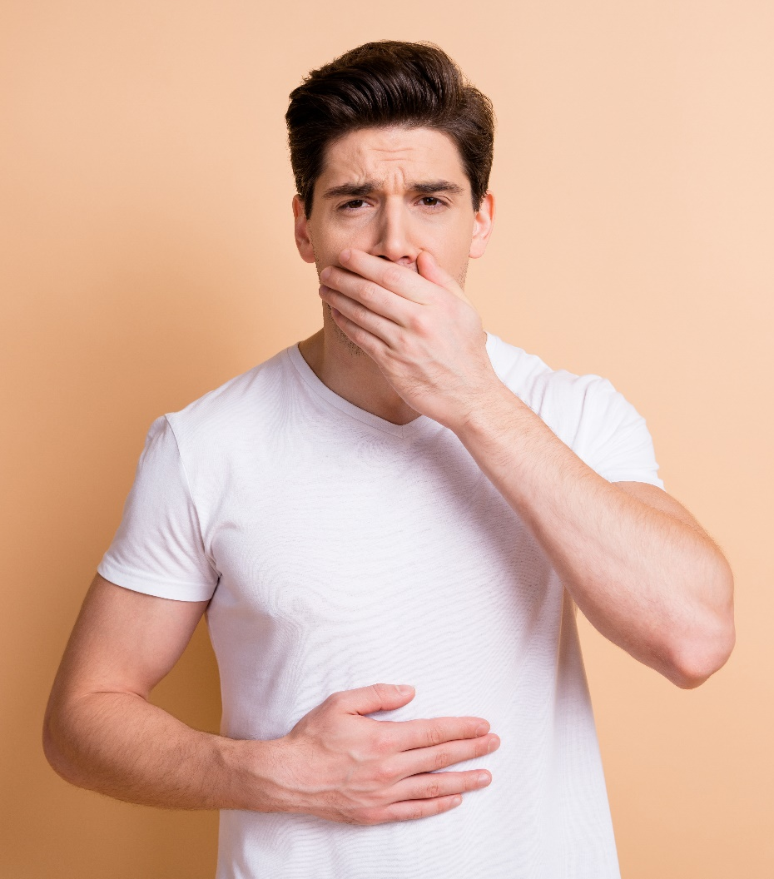
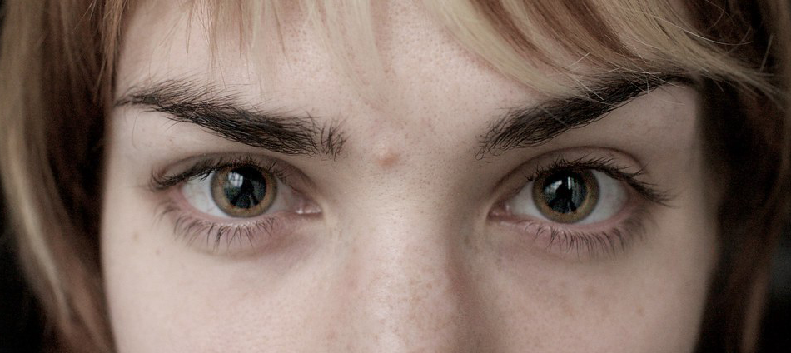
Drugs in the Human Body

Slide 4
What is a Drug?
A drug is any substance that, when taken into the human body, can impair the ability of the person to operate a vehicle safely.

Slide 5
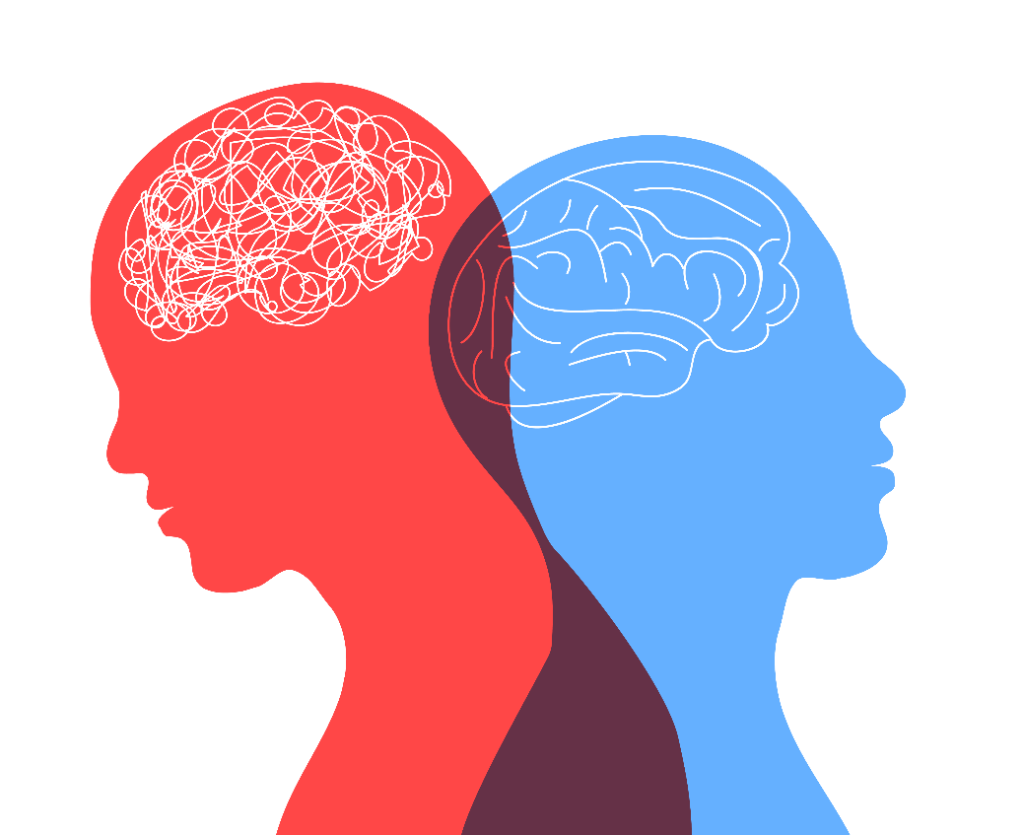
Psychoactive Drugs
A chemical that alters brain/body function resulting in temporary changes in:
  Perception
  Mood
  Consciousness
  Behavior

Slide 6
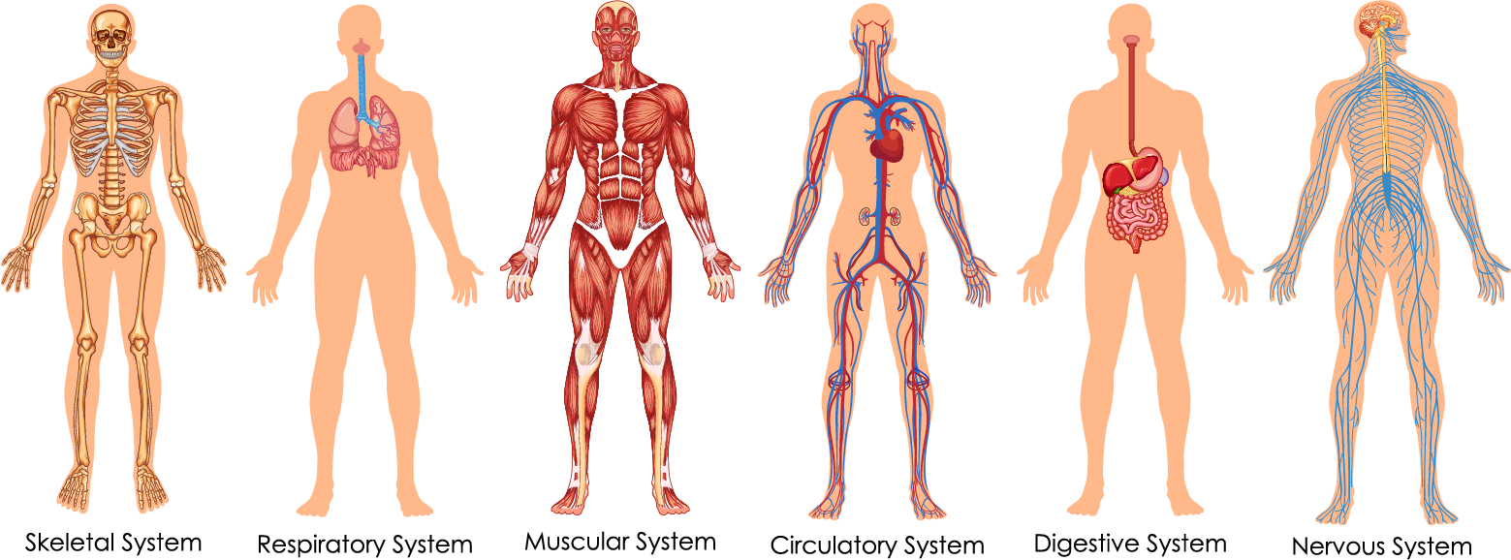
Major Systems of the Human Body

Slide 7
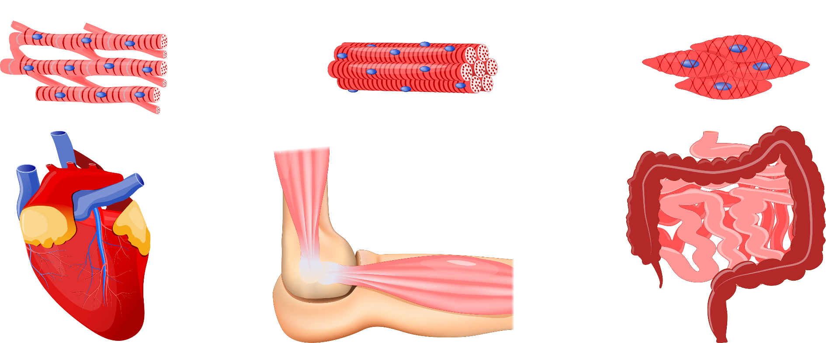
Muscular System
Cardiac Muscles
Striated Muscles (“voluntary”)
Smooth Muscles (“involuntary”)
Heart

Slide 8
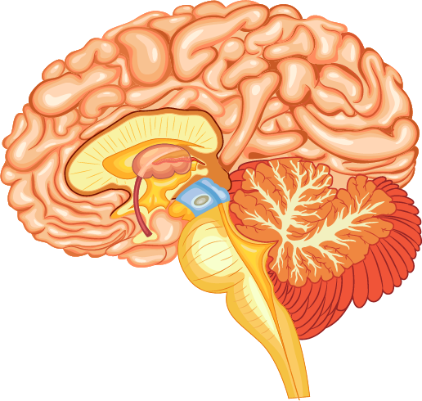
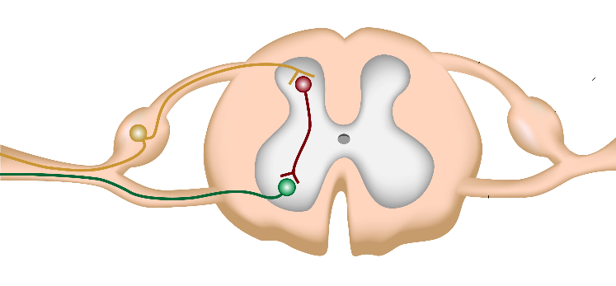
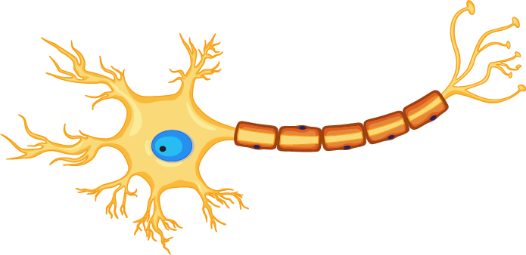
Nervous System
Brain
Spinal Cord
Nerves

Slide 9
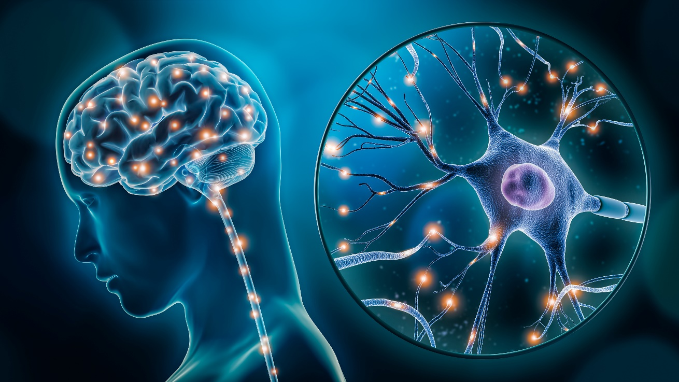
Brain
Neurons
Neurotransmitters

Slide 10
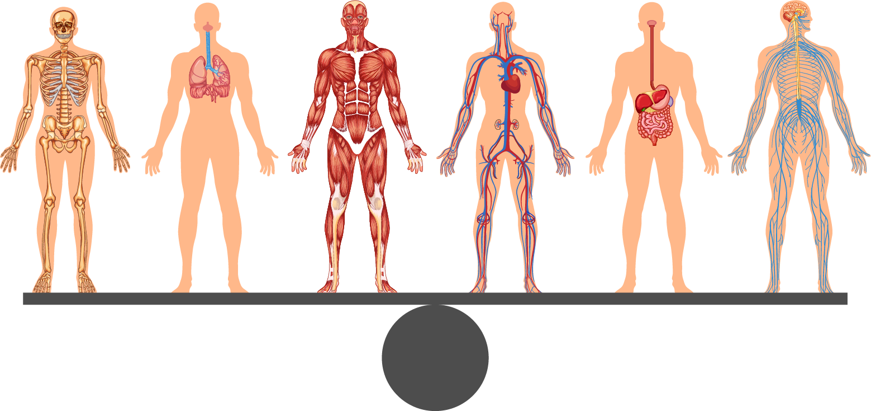
Homeostasis
Homeostasis is a dynamic, self-regulating process by which the body maintains a balanced or constant state while adjusting to internal and external conditions.

Slide 11
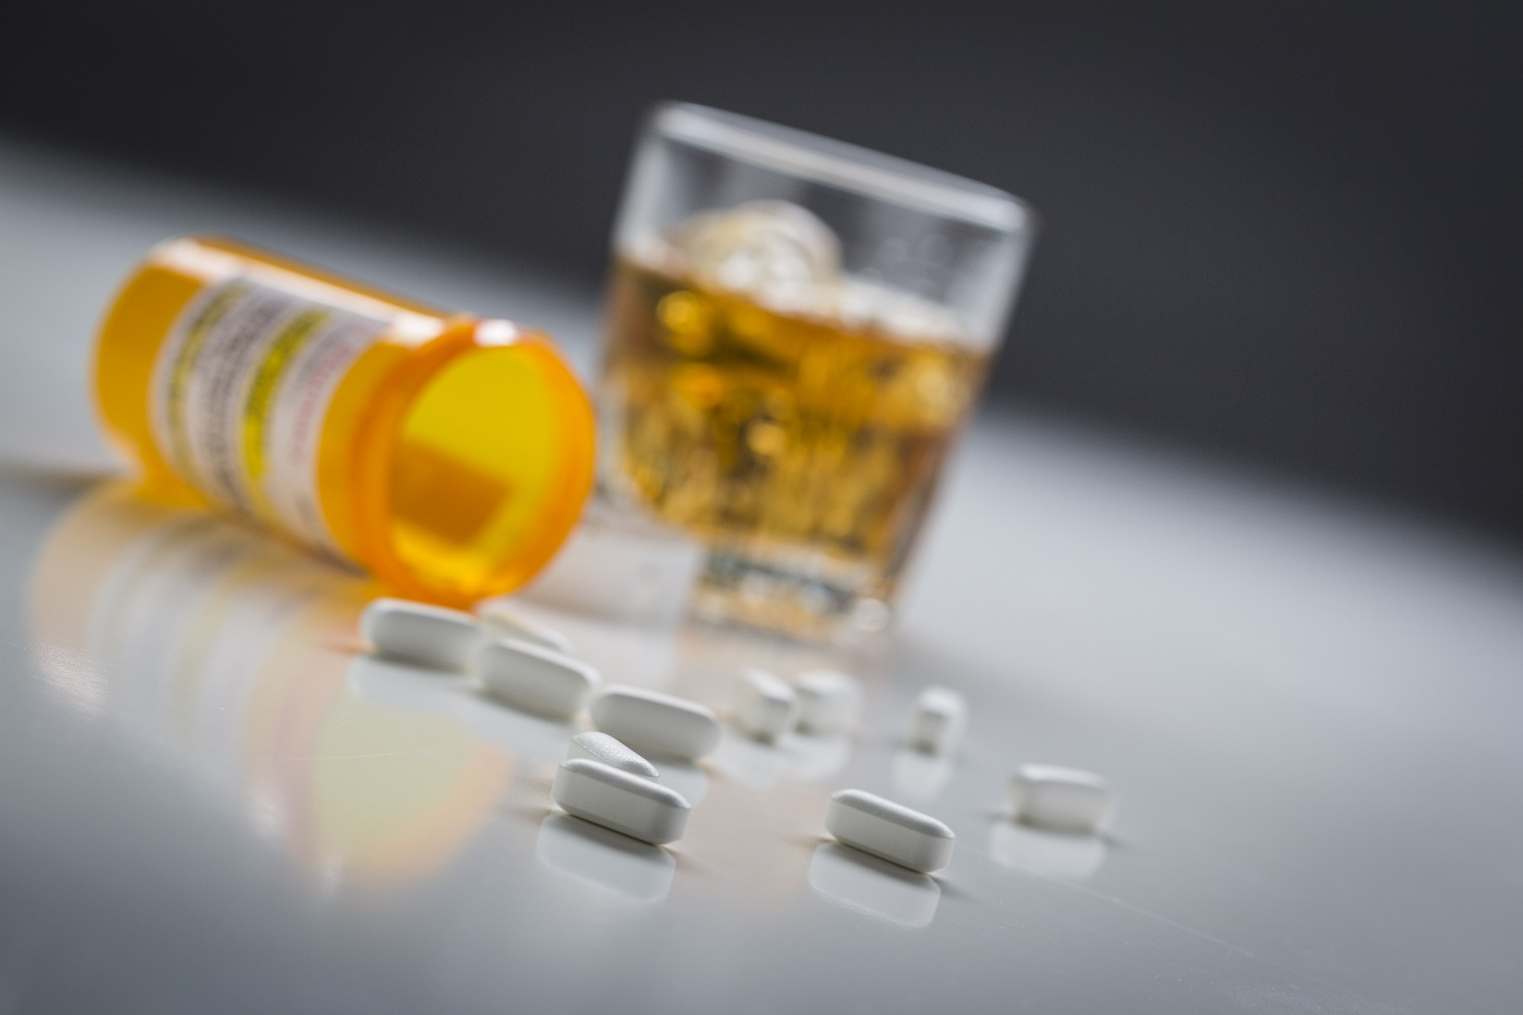
Interactions of Drugs and the Body

Slide 12
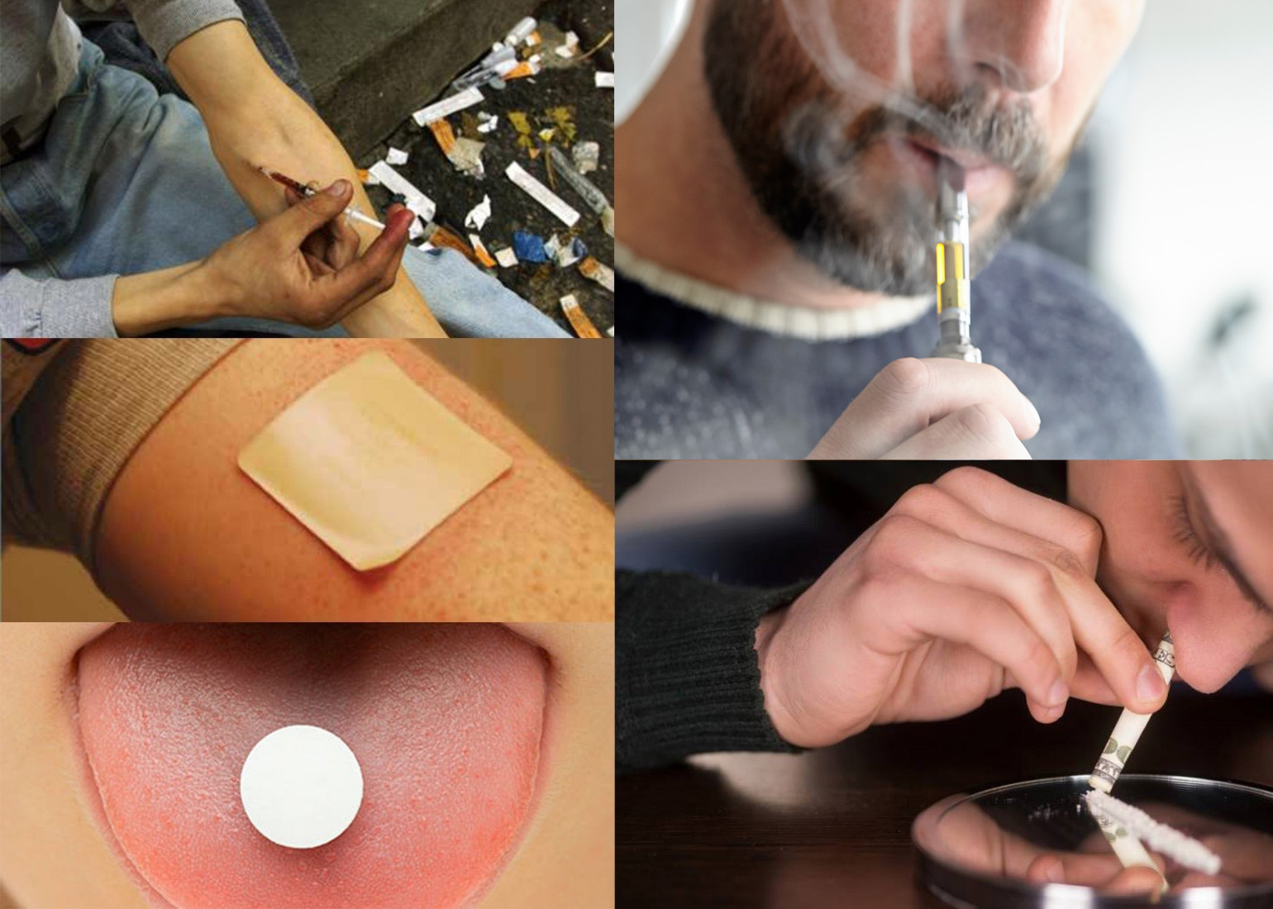
Methods of Administration

Slide 13
Medical Conditions That May Mimic Drug Impairment
Head Trauma
Stroke
Diabetes
Shock
Multiple Sclerosis
Other Conditions

Slide 14
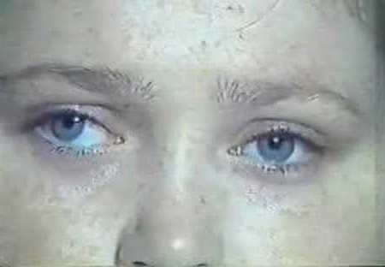
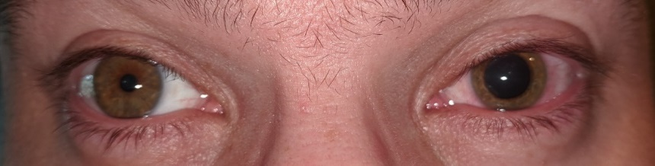
Head Trauma
Confusion
Disoriented
Lack of coordination
Slowed responses
Speech impairment
Unequal pupils
Unequal tracking

Slide 15
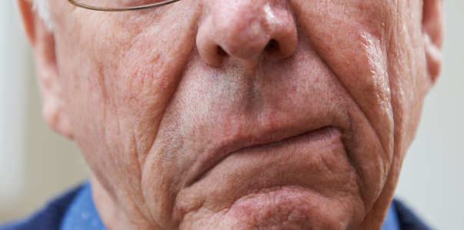
Stroke
Unequal pupils
Weakness on one side of the body
Slurred speech, facial droop
Confused, frightened

Slide 16
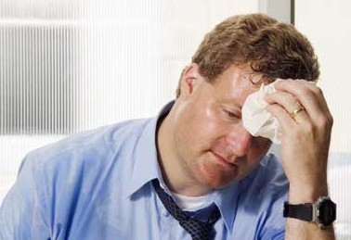
Diabetes
Confused or non-responsive
Sweat profusely
Cold, clammy skin
Rapid, weak pulse
May require immediate medical attention

Slide 17
Shock
Occurs when the body is not getting enough blood flow
Requires immediate medical attention
  Dazed
  Uncoordinated
  Non-responsive

Slide 18
Multiple Sclerosis
May lack coordination
Tremors
Slurred or garbled speech
May appear alert and responsive to questions

Slide 19
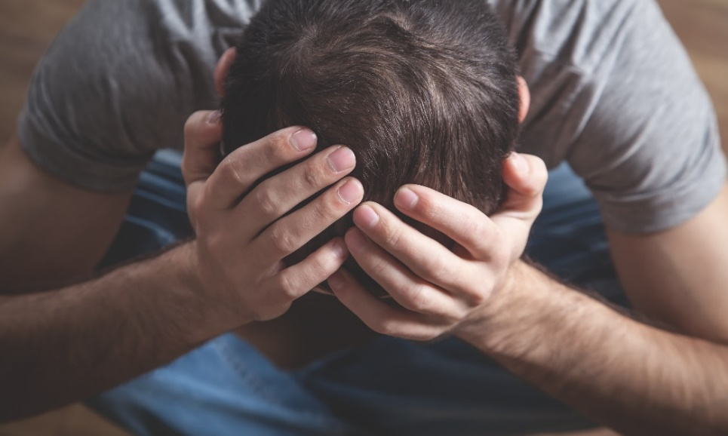
Mental Health
Anxiety (Panic Disorder)
Depression
Bipolar Disorder
Schizophrenia

Slide 20
Questions?

