Slide 1
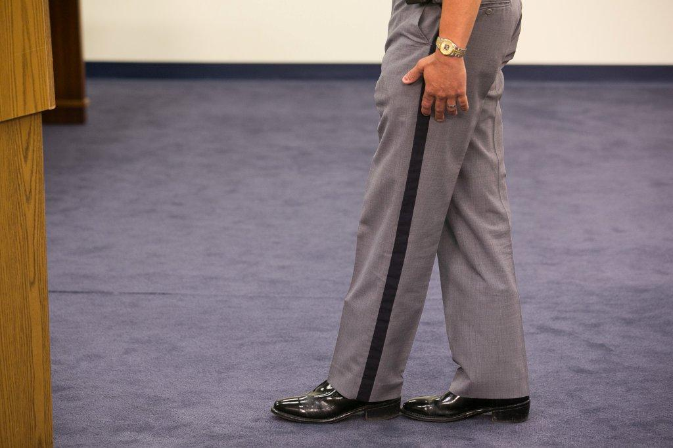



Session 13
Alcohol Workshop:
Second Session

Slide 2

Learning Objectives
  Properly administer SFSTs
  Properly observe and record subject’s performance utilizing field note-taking guide
  Properly interpret subject’s performance

Slide 3
Administer SFSTs
  Volunteers who have consumed alcohol
  Each team member will administer one complete series of tests to at least one drinking volunteer
  Each team prepares a descriptive, written test record on each volunteer tested

Slide 4
Hands On Practice

Slide 5
Session Wrap Up
  SFST results on each volunteer
  Observations concerning the relationship between volunteers' BACs and their performances on the tests

Slide 6
Questions?

